Slide 1
Prediction of Credit Defaulters
A summary

Slide 2
INTRODUCTION
The task is to predict on some given parameters, whether a customer will pay the micro-credit availed in a particular time.
This is a binary classification problem where 0 stands for the customer has failed to pay the credit and 1 stands for customer has successfully paid the credit back.
As binary classification logistic regression will be the first approach.

Slide 3
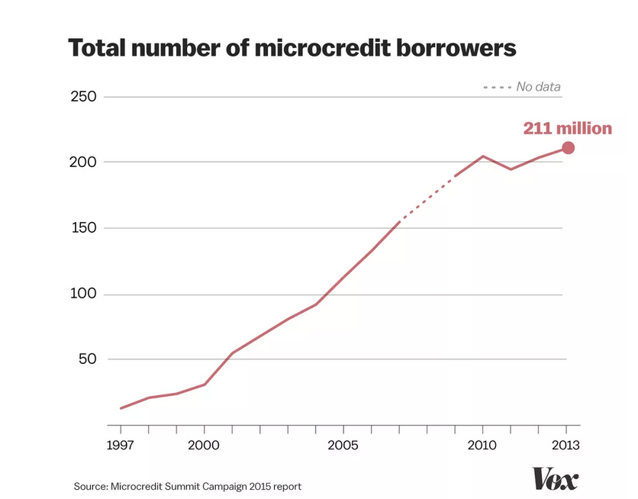
The following graph shows the increase in the number of microcredit borrowers

Slide 4
Analytical Problem Framing
In the given data we have various parameters which are used to predict the label.
All the other variables are independently collected data which will help us formulate the target

Slide 5
Data Preprocessing
Outliers were dropped using the ZScore method.
PCircle and PDate were the first columns to be dropped as PCircle has only one value and PDate is the date the customer pays the microcredit
phone number of the user will not help us in predicting the target
Cleaning was also done by dropping the duplicated entries

Slide 6
Hardware and Software Requirements
Hardware used: system memory 8GB, Processor: 5th gen core i7
Model is developed on Jupyter Notebook

Slide 7
Inferences from visualizations
Target is highly imbalanced.
Data is skewed.
There are some features which are highly correlated.
Some features are least negatively correlated with target

Slide 8
Model/s Development and Evaluation
As this is a binary classification, the first approach here was logistic regression.
Classification algorithms like Random Forest Classifier, Switched Vector Classifier.

Slide 9
Results
Applying logistic regression gives us a good accuracy but prediction of 0s is very bad
If we use Random Forest Classifier accuracy increses and ability of model to predict zeroes accurately also increases.
We need to employ GridSearchCV for hyperparameter tuning to get better results in predicting the zeroes

Slide 10
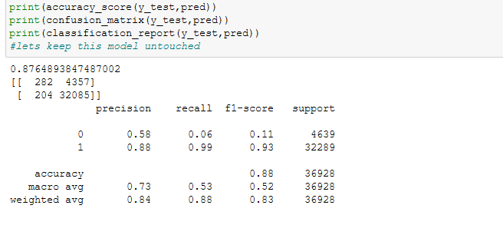
Logistic Regression

Slide 11
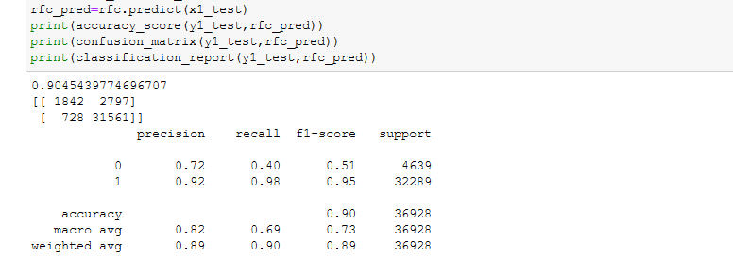
Random Forest Classifier

Slide 12
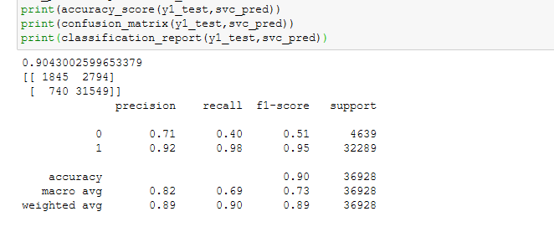
Switched Vector Classifier

Slide 13
CONCLUSION
Data Cleaning is an important step to develop a better performing model.
Outliers in model will impact the performance of the model to great extent.
Ensembling techniques can be used to improve the performance of the model
HyperParameter tuning techniques will result in better performance of the model.
Vizualization of data gives us a detailed view of what data actually is

